Slide 1


LoRea - A backscatter architecture that achieves a long communication range
Ambuj Varshney¹, Oliver Harms¹, Carlos Perez-Penichet¹,
Christian Rohner¹, Frederik Hermans¹, Thiemo Voigt^{1,2}
Uppsala University, Sweden ¹
RISE SICS, Sweden²
ambuj.varshney (at) it.uu.se
ambuj.se

Slide 2
LoRea’s contributions
  LoRea reimagines the backscatter architecture to achieve longest demonstrated communication range (3.4 km) while consuming tens of µWs at the tag

Slide 3
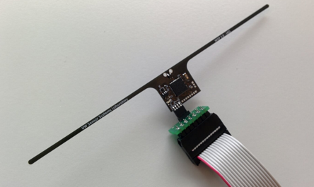

Computational RFIDs
Augment RFIDs with sensing and computational capabilities
Prototype battery-free applications (cameras, microphones)
Severely constrained by the limitations of UHF RFID reader
  Expensive (> 1000 USD) and short range (< 18m)
Moo 1.0
University of Massachusetts
WISP 5.0
University of Washington

Slide 4
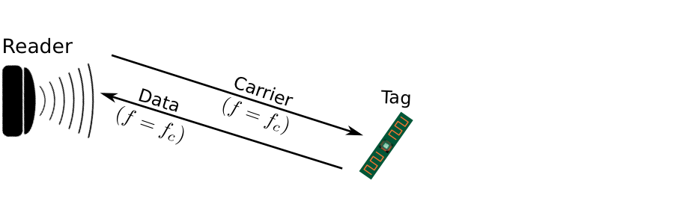
Why are backscatter readers constrained ?
Backscatter tags transmit at the same frequency as the carrier signal
  Complex and expensive self-interference cancellation mechanisms
    Low range due to poor sensitivity and leakages of the carrier signal
Notes:
So, why are existing backscatter readers so constrained? One of the important
Reasons for this is that on existing backscatter systems tags transmit at the same frequency as the
Carrier signal. This causes a severe self-interference to the weak backscatter transmissions.
This requires the use of complex techniques and self-interference cancellation mechanisms
Which increases both the complexity and price of the reader device.
Further, most existing RFID readers are a single device used to provide carrier signal to power
The backscatter tag, receive transmissions. These readers generate a strong carrier of 2-4 Watts
Which severely increases the power consumption of the unit.

Slide 5
LoRea’s contributions
Simplified self-interference mitigation mechanism lowers cost of reader
Narrowband transmissions achieve orders of magnitude longer range
Commodity devices as carrier generators improve scalability
Unison backscatter helps operate in interfered wireless environments

Slide 6
Achieving long communication range and low cost

Slide 7
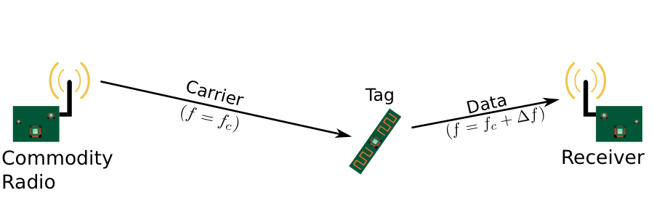
Decoupling carrier generation and reception
Bi-static setup spatially separates carrier generation from the receiver
Self-interference reduced due to path loss suffered by carrier signal
Monostatic configuration
Bi-static configuration
Notes:
Decouple in space, spatial seperation

Slide 8
Decoupling carrier generation and reception
Bi-static configuration has two configurations with high signal strength
Monostatic signal strength (RFID readers)
Bi-static signal strength (LoRea)
Notes:
Decouple in space, spatial seperation

Slide 9
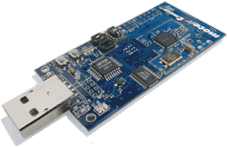
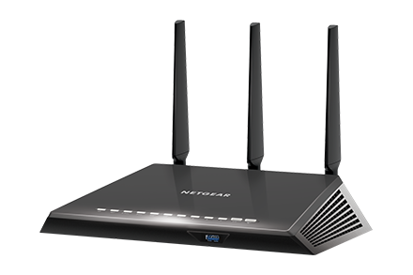
Commodity devices as carrier generators
Interscatter [1] demonstrated BLE radios can generate carrier signal
LoRea goes a step beyond: WiFi and 802.15.4 radios
Key idea: Test mode present for compliance testing
  Majority of radio chips - WiFi, BLE, ZigBee, LoRa
[1] Iyer et al. "Inter-technology backscatter: Towards internet connectivity for implanted devices.” – SIGCOMM 2016

Slide 10
Simplifying self-interference mitigation
Backscatter is a mixing process [1]
Separation in frequency of backscatter transmissions and carrier signal reduces interference from carrier to weak backscatter transmissions
[1] Zhang et al. " Enabling Practical Backscatter Communication for On-body Sensors” – SIGCOMM 2016

Slide 11
Simplifying self-interference mitigation
Transceivers attenuate interference at adjacent frequency channels.
No complex self-interference mechanisms required at reader
Adjacent channel
bandpass filter
50 dB attenuation
Receiver center frequency
Carrier
signal
F_{c}
Backscatter
Transmission
Fc + ΔF
Frequency
[1] Zhang et al. " Enabling Practical Backscatter Communication for On-body Sensors” – SIGCOMM 2016

Slide 12
Achieving orders of magnitude longer range
Key idea: Receiver sensitivity improves with lower bandwidth
Lower bitrate (2.9 KBit/s) generates narrow bandwidth transmissions
Frequency shift keying as a modulation scheme
How does this relate to the bandwidth of ZigBee, WiFi and BLE ?
  Order(s) of magnitude lower bandwidth
  LoRea sensitivity - 40 dB lower than minimum detectable by WiFi radios
Operating frequency | Bandwidth
868 MHz | 13 KHz
2.4 GHz | 180 KHz

Slide 13
Unison backscatter

Slide 14
Unison backscatter
Surrounded by multiple wireless devices – routers, sensor nodes
Key idea: Backscattering reflects all impinging signals on the antenna

Slide 15
Unison backscatter
Surrounded by multiple wireless devices – routers, sensor nodes
Key idea: Backscattering reflects all impinging signals on the antenna

Slide 16
Unison backscatter
Surrounded by multiple wireless devices – routers, sensor nodes
Key idea: Backscattering reflects all impinging signals on the antenna
Unison enables operation in the interfered wireless environments by backscattering simultaneously on multiple frequencies
Notes:
Next, we present an onverview of our backscatter architecture.
We have one or more commodity wireless devices that provide
The carrier signal which are reflected by the tag, and received by
one or more commodity receivers.

Slide 17
Backscatter tag

Slide 18
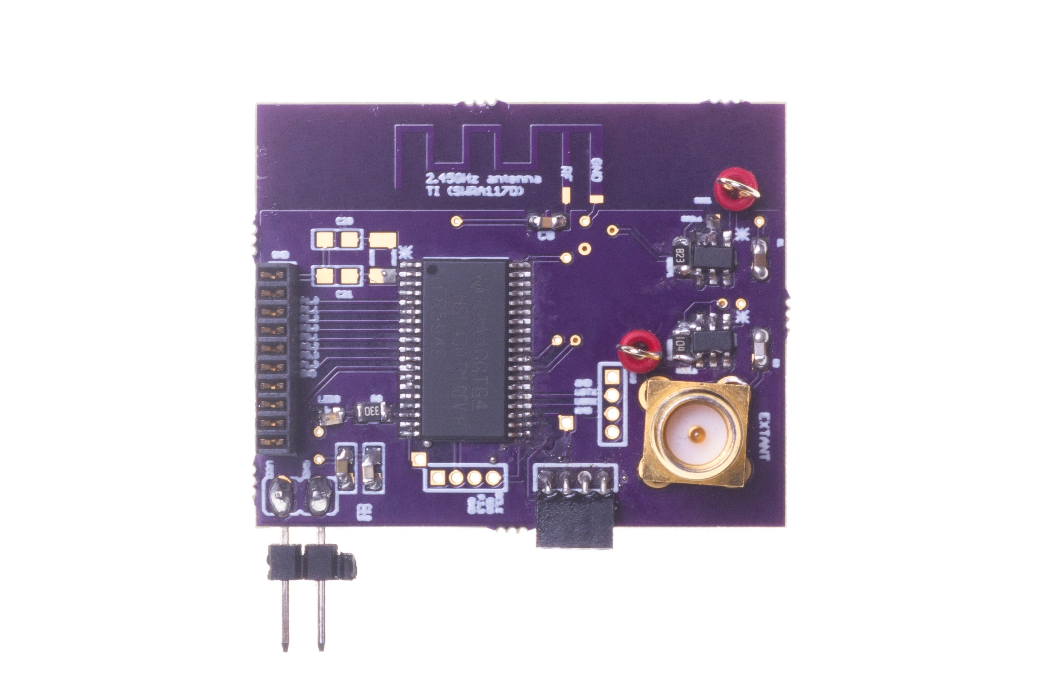
Battery-free backscatter tag
Peak power consumption at the tag for backscatter transmissions -
Operating frequency | Peak power consumption
868 MHz | 70 µW
2.4 GHz | 650 µW
Hardware prototype
Notes:
Backscatter tag is also a crucial part of our architecture. To achieve ultra low power we present a novel design
Of a FSK backscatter tag. Here we present the schematic of the tag, it consists of two ultra low powr oscillator
Which generate frequency correspondiong to two symbols )0 and 1), Based on the input symbol these frequency are
Selected using mux, and controls an RF switch which controls the reflection of the impinging RF signal.
The backscatter tag is built using off the shelf componenents, and consumes peak power of 70 microwatts and 650 microwatts
For operating at sub GHz or 2.4 GHz frequency band. The peak power can be easily provided by many ambient sources
Such as RF signals, small solar cells or other harvesting sources.
The higher powerr consumption for 2.4 GHz tag is due to need to generate
Higher IF. A IC implementation of the tag could further reduce power consumption
to only few tens of microwatts.

Slide 19
Evaluation

Slide 20
Experiment settings
Communication range scales with the carrier signal strength
Experiment performed in two different environments
100 randomly generated packets, 36 bytes, Transmitted bits - 10⁵
Operating frequency | Carrier strength
868 MHz | 28 dBm
2.4 GHz | 26 dBm
Notes:
⁵

Slide 21
What should be the intermediate frequency ?
Dependent on the transceiver used, and also receive bandwidth [1]
CC1310 (868 MHz)
CC2500 (2.4 GHz)
Operating frequency | Intermediate frequency
868 MHz | 100 KHz
2.4 GHz | 2 MHz
Intermediate frequency required for 50 dB attenuation of the self-interference from carrier signal
[1] Varshney, Ambuj, et al. ”Towards Wide-area Backscatter networks” – ACM HOTWIRELESS 2017
Notes:
Moving away cost energy, talk about this.
First experiment, how much to shift
No experiment, describe only result.
Shift and tradeoff
The ability of transceievers to attenuate career signal, and reduce self-interference
Is dependent on the transceiver used, but also the receiver bandwidth, as we had shown
In our work presented couple of weeks back at ACM HOTWIRELESS.
This means that for a narrow receiver bandwidth
We can achieve a significant rejection even at small frequency
offsets which is important
To operate on shared spectrum.
We performed an experiment to understand what should be the choice of
Intermediate frequency. We setup an SDR to generate a carrier signal, and sweep
Its frequency from center of the receiver to a positive and negative offset away from
The center frequency.
We observe that the transceiever used for sub GHz operations attenuates interference from carrier
Present 100 KHz away by almost 50 dB, similarly, the transceiever at 2.4 GHz attenuates at 2 MHz away
And it does not reduce signficiantly any further. Hence, we select these as intermeidate frequency
For transmission at the backscatter tag.

Slide 22
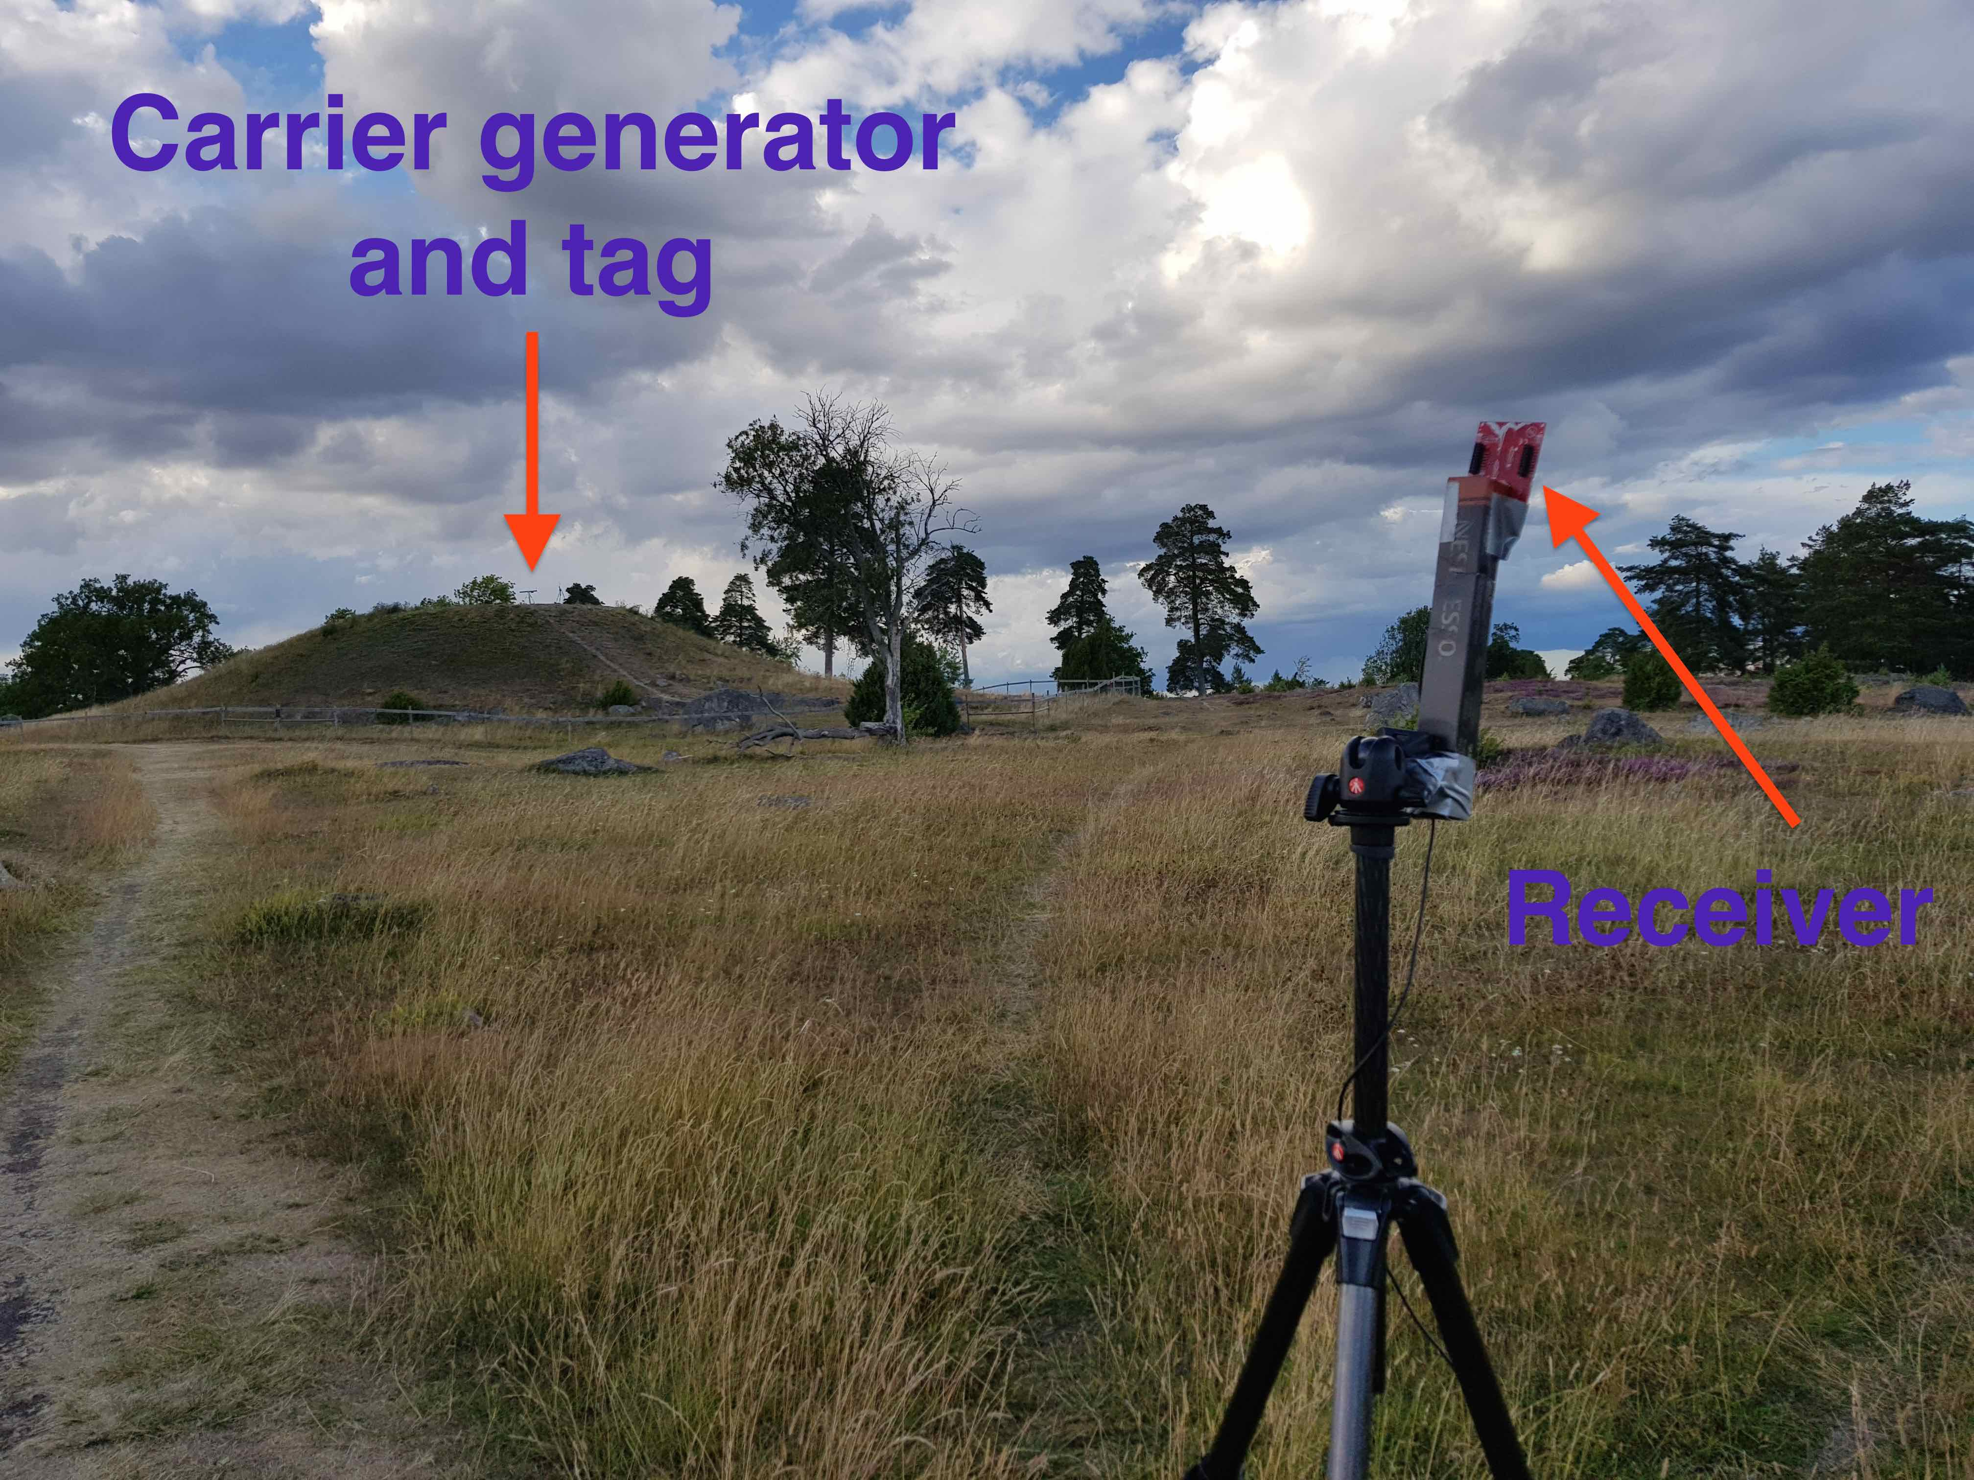
Tag in proximity of carrier source (868 MHz)
Receive transmissions even at a distance of 3.4 kilometers from tag
Highest demonstrated range with backscatter communication
Notes:
Comparable to other backscatter systems the BER

Slide 23
Tag in proximity of carrier source (2.4 GHz)
Receive backscatter transmissions even at a distance 225 meters away
Highest demonstrated range at 2.4 GHz band with backscatter
LoRea achieves a range of Hundreds of meters while consuming µWs of transmission power at the tag

Slide 24
Range of state-of-the-art systems
System name | Communication range
RFID | < 18 m
BackFi (SIGCOMM 2015) | 5 m
Passive WiFi (NSDI 2016) | 30 m
HitchHike (SENSYS 2016) | 54 m
Interscatter (SIGCOMM 2016) | 30 m
LoRa Backscatter (UBICOMP 2017) | 2800 m
LoRea – 868 MHz (SENSYS 2017) | 3400 m
LoRea – 2.4 GHz (SENSYS 2017) | 225 m
Range reported are line of sight, with backscatter tag co-located with carrier source

Slide 25
Comparison with CRFIDs
WISP 5.0 used as CRFID platform
  Powered to limit affects of asymmetric harvesting and communication range
LoRea – 2.4 GHz architecture
  Simulate equivalent path loss, tag in middle of carrier generator and receiver
LoRea achieves significantly longer communication range when compared to state-of-the-art CRFID platform

Slide 26
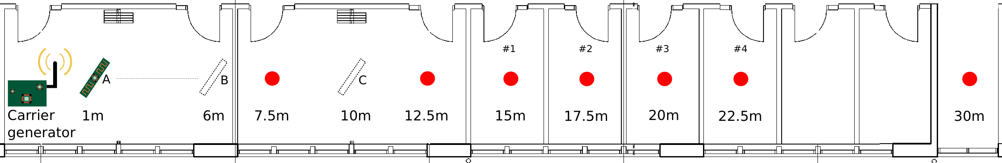
Non line of sight (2.4 GHz)
We can receive backscatter transmissions even when tag and receiver are separated by several walls in a modern building

Slide 27
Unison backscatter
Three WiFi devices (CC3200) as carrier generators
WiFi Interferer – 6 meters away from the receivers

Slide 28
Unison backscatter
Unison backscatter transmits identical messages on multiple frequencies to support operation in the interfered environment

Slide 29
Conclusions
First backscatter system to achieve kilometers (co-located carrier)
Can leverage WiFi routers, sensor nodes for carrier signal generation
Unison backscatter enables operation in interfered wireless environments
LoRea enables new and challenging new applications
  Sensors embedded in the infrastructure
  Mobile backscatter readers

Slide 30
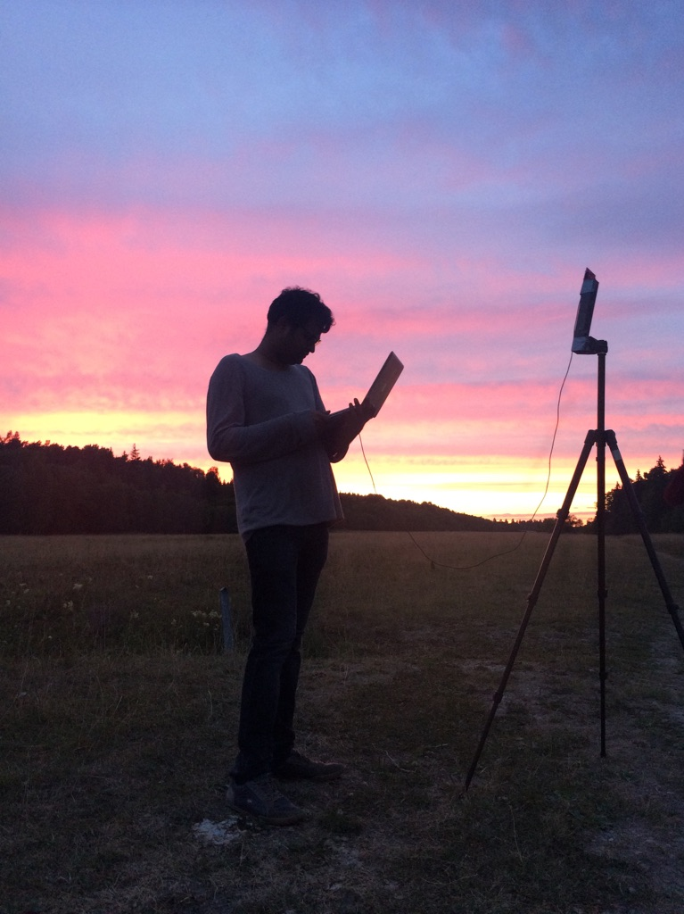
Q & A

Slide 31
Reserve slides

Slide 32
Sensors embedded in the infrastructure
Sensors have to be left in infrastructure for long periods
  Changing battery is difficult
Existing deployments with CRFIDs small range (centimeters)

