Slide 1
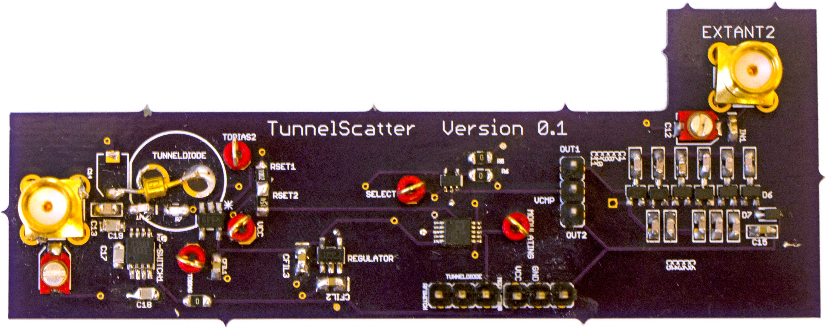


TunnelScatter - Low Power Communication for Sensor Tags using Tunnel Diodes
Ambuj Varshney¹, Andreas Soleiman¹, Thiemo Voigt^{1,2}
¹Uppsala University, Sweden and ²RISE SICS, Sweden
TunnelScatter Prototype
Notes:
- Introduce
Andreas, mentoring 2 years (Ambitious?)
THiemo

Slide 2
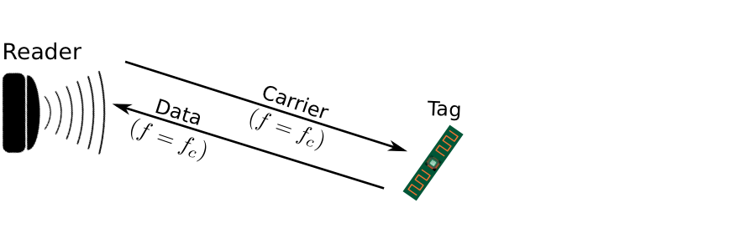
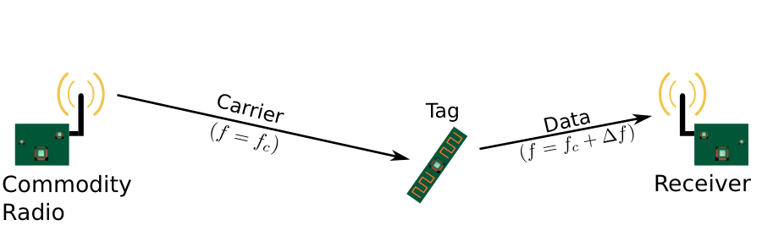
Backscatter Communication
Low-power transmission mechanism
Reflects external carrier signal
RFID Systems
LoRea (SenSys 2017)
Challenge: Tags needs to be in proximity to a strong external carrier signal emitter for practical range
Notes:
Sustainable sensing deviceS and IoT applications.
Backscatter A key technology, a low-power transmission mechanism
Backscatter enables transmissions at tens of microwatts by reflecting external carrier signal.
RFID most widespread backscatter system. Describe RFID.
Recent not systems use bistatic. Carrier generation and reception delegated to separate devices. One example, LoRea (explain). Similar setup used to generate commodity protocols such as ZigBee, WiFi, BLE etc
- Key challenge, strong carrier signal (few hundred mills watt to few watt) and tag located in proximity. Give example LoRea.
Hinders widespread deployment of Backscatter applications.

Slide 3
TunnelScatter with Weak External Carrier Signal
-27 dBm carrier signal emitter, tag at a distance of 1m
Achieves multi-floor communication!
  With LoRea (SenSys 17) at carrier strength of 28 dBm
BER
RSSI
Notes:
- To overcome this challenge, TunnelScatter
One of the features of TunnelScatter, weak carrier signal
-Achieves by supporting significant gain at tag while reflecting weak external carrier signal
As an example, we provide teaser for one experiment conducted in paper. Tag located at a distance of 1 m from carrier emitter generating -27 dBm signal. This represents radiated power of YY microwatt for emitter
-Transmit to several floors of university building, as we see in the graphs on the slide which represents BER and signal strength
- We only achieved similar range with LoRea at carrier a strength of 28 dBm

Slide 4
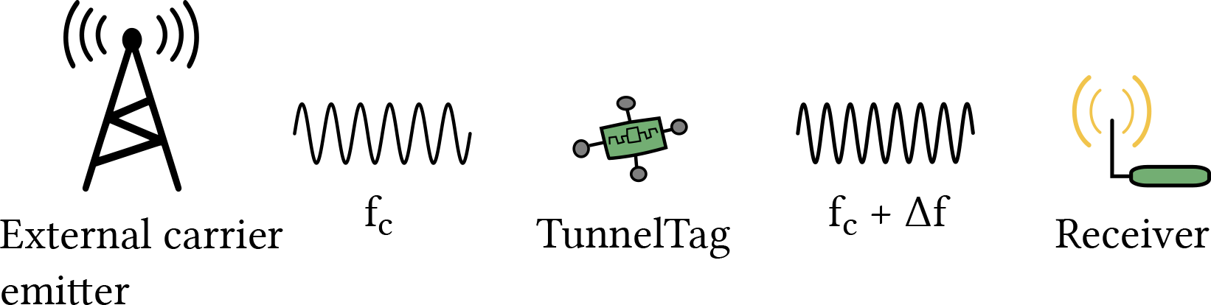
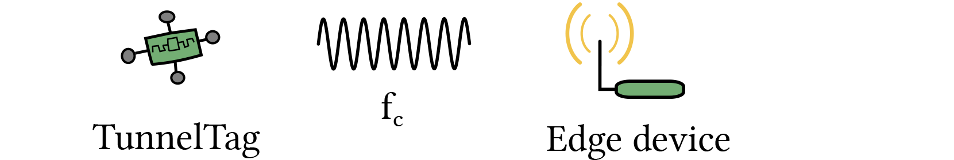
TunnelScatter
Weak external
carrier signal
Without external
carrier signal
  TunnelScatter leverages tunnel diodes to enable low-power communication even without ambient carrier signal
Notes:
Ability to reflect weak carrier signal with significant gain means now our backscatter tag which we call tunnel tag can be located at a much larger distance from carrier signal emitter.
- However, the key feature of the tunnel scatter is that it enables TunnelTag to communicate even without external carrier signal like a conventional radio. TunnelTags achieve this will consuming tens of microwatts similar to a backscatter transmitter.
- TunnelScatter achieves this capability using these fascinating devices that are tunnel diodes.

Slide 5
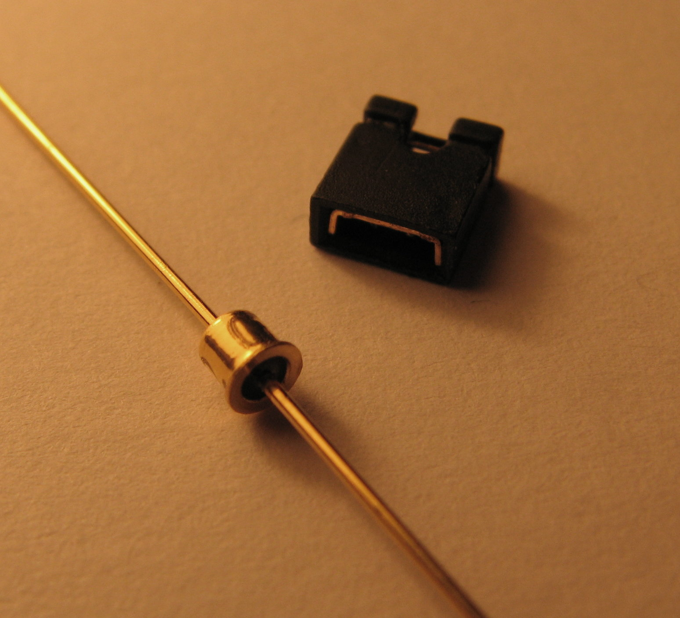
Tunnel Diodes
Demonstrate Quantum Tunneling. Observed in 1950s
Show a region of negative resistance
Tunnel diodes are inherently low-powered devices
Negative resistance at microwatts enables the design of RF amplifiers and oscillators for energy harvesting sensor tags
Tunnel Diode
IV Curve [1N3712]
Power consumption [1N3712]
Notes:
-Tunnel diodes are highly doped P-N junction semiconductor devices
- These diodes show a phenomenon called quantum tunneling which was discovered in late 50s, and led to its inventors being awarded Nobel prize in physics in 1973
- Due to quantum tunneling tunnel diodes show a negative resistance, i.e., as we see in graph the current drops with increasing voltage. This happens at tens of microwatts of power consumption making these devices suitable for energy harvesting system.
- Negative resistance characteristics of tunnel diode enable use of these devices for design of amplifiers, oscillators etc as we show in TunnelScatter.

Slide 6
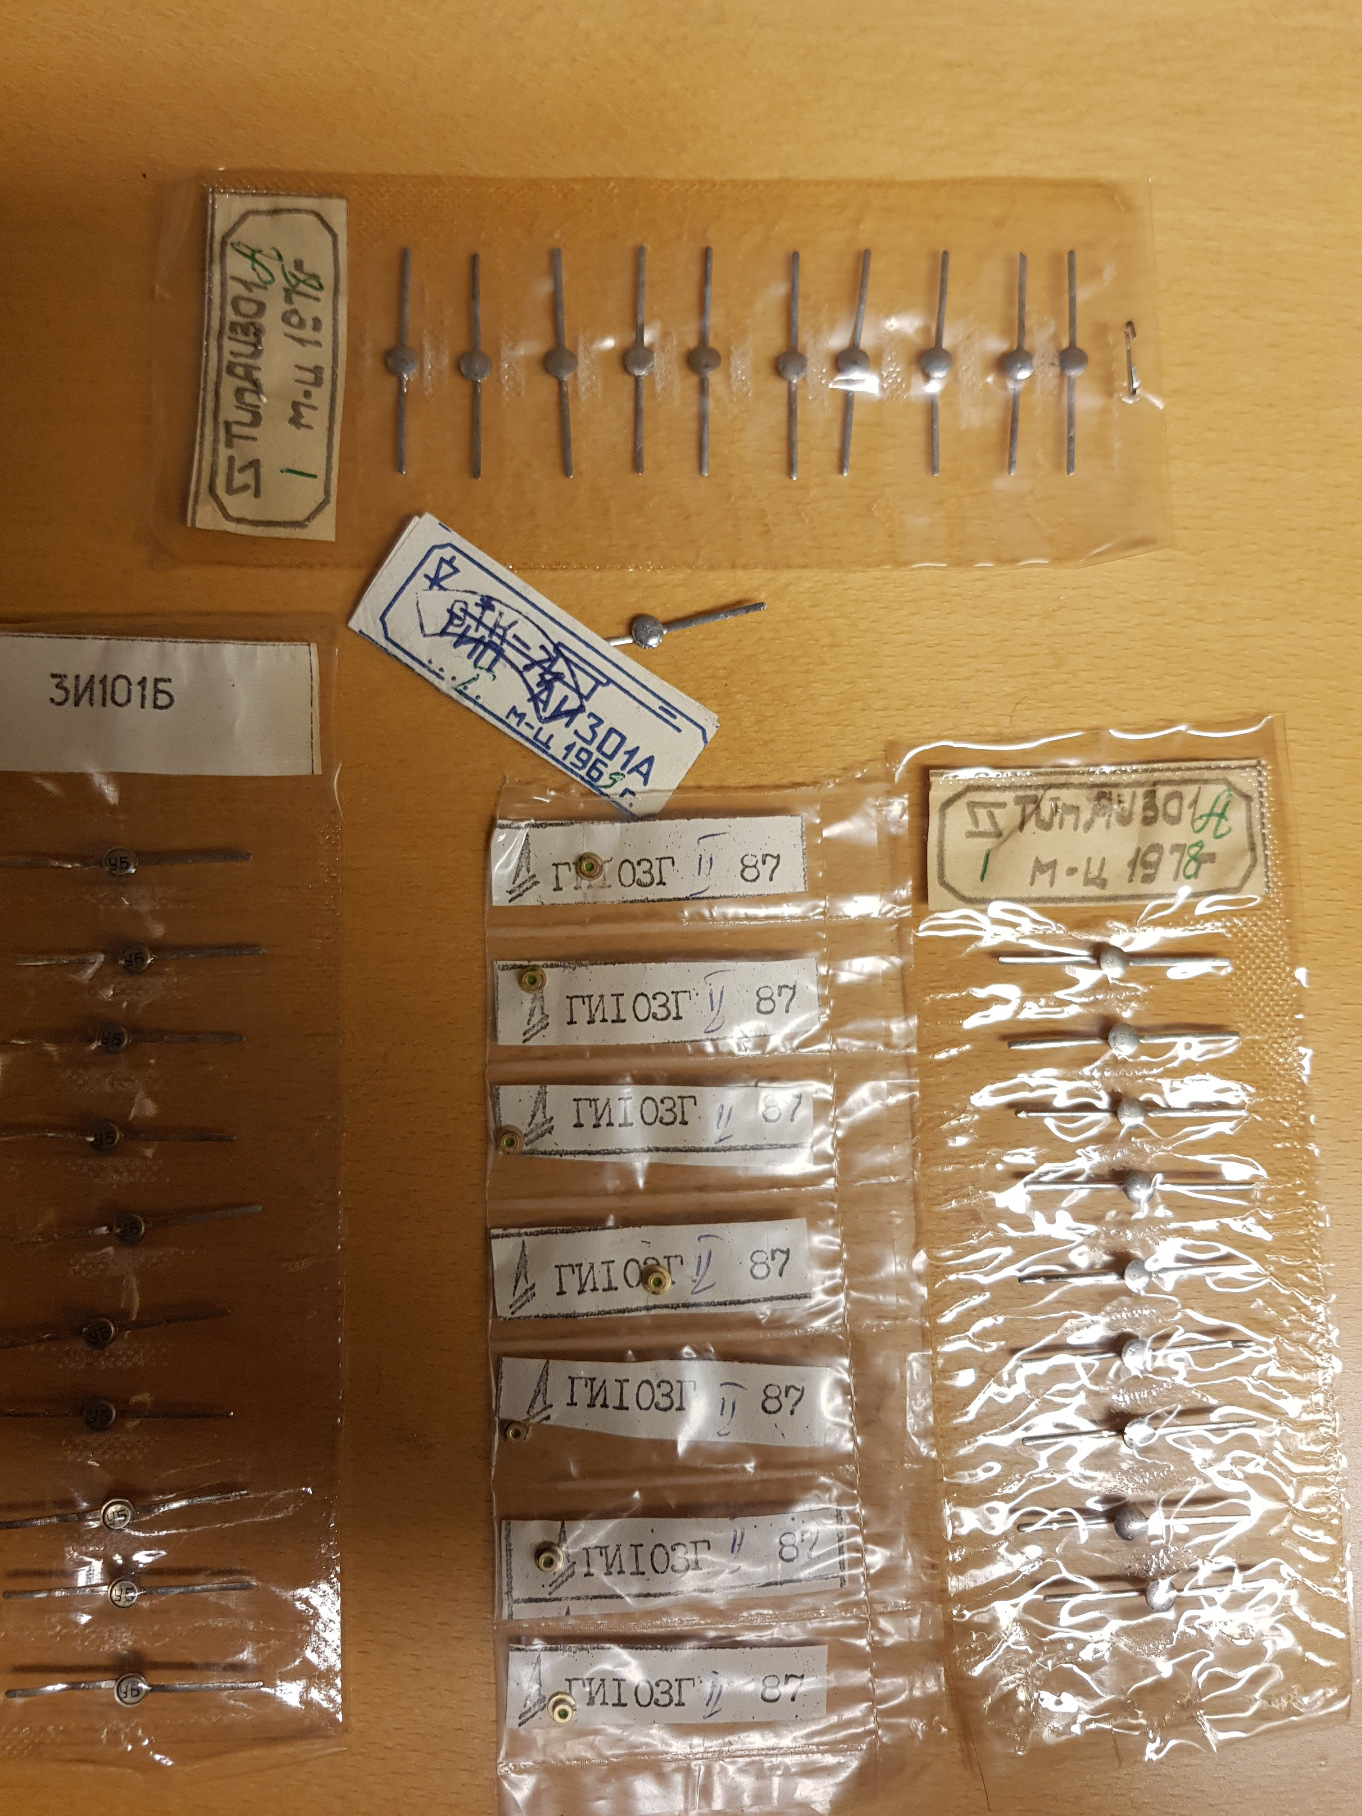
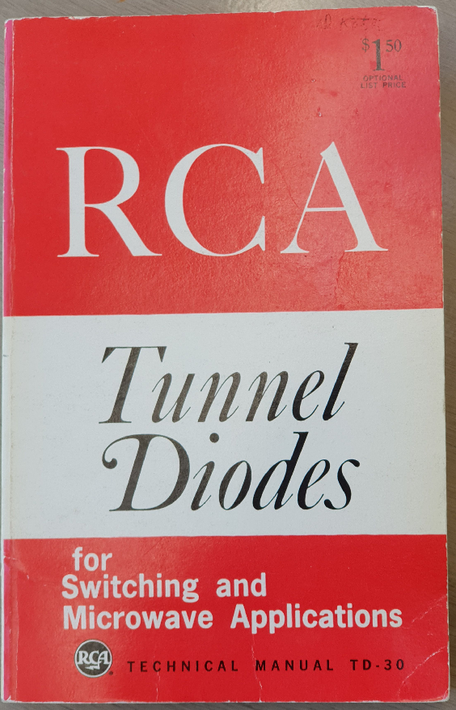
Tunnel Diodes
Availability of tunnel diodes is a challenge
We use tunnel diodes fabricated during 1960s/70s
Valuable resources are old patents and manuals from the 1960s
Russian Tunnel Diodes
Tunnel Diode Manual
Notes:
-Tunnel diodes are highly doped P-N junction semiconductor devices
- These diodes show a phenomenon called quantum tunneling which was discovered in late 50s, and led to its inventors being awarded Nobel prize in physics in 1973
- Due to quantum tunneling tunnel diodes show a negative resistance, i.e., as we see in graph the current drops with increasing voltage. This happens at tens of microwatts of power consumption making these devices suitable for energy harvesting system.
- Negative resistance characteristics of tunnel diode enable use of these devices for design of amplifiers, oscillators etc as we show in TunnelScatter.

Slide 7
TunnelScatter without External Carrier Signal
Requires on-board signal generation
Tunnel diodes enable design of high frequency oscillators
Tunnel diode oscillator consumes a peak power of 57 microwatts
Notes:
- To transmit in the absence of ACS, we need to be able to locally generate a carrier signal
Challenging, as existing backscatter systems, only generate a low frequency signal at tens of MHz.
However we require generating a high frequency RF signal at hundreds of MHz of oprating frequency
We overcome this challenging by using tunnel diodes to desing a RF oscillator
If we look at the spectrum, we observe we can generate a carrier signal of strength -19 dBm.
This is a weak signal, however, modern radio transcieevrs such as used for LoRa achieve very high sensitivity (-149 dBm)
We are able to achieve this while consuming a peak power consumption of only 57 microwatts!
Having a high frequency TDO enables us to transmit even without requiring an ACS
****
Modify First Point
*****
Make Enables bold
***
Make frequency of the oscillator
Explicit
*****
868 MHz ISM band for LoRa, etc
*****
Weak ACS without TDO
*******

Slide 8
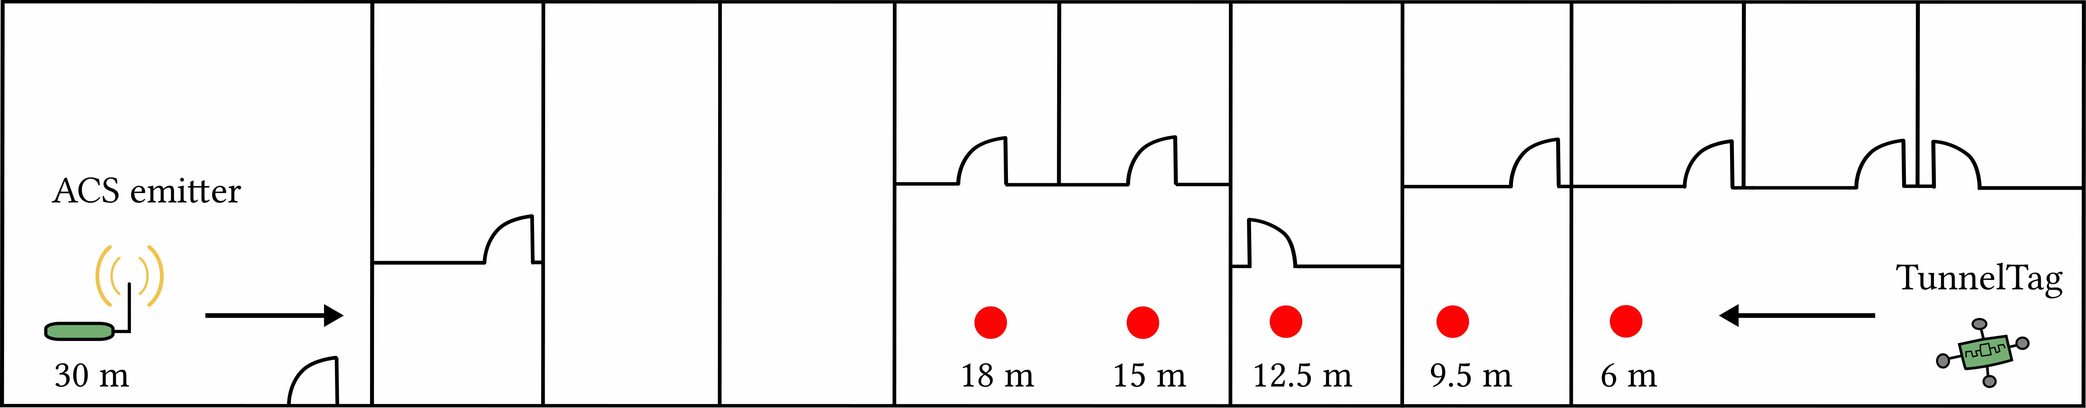
TunnelScatter without External Carrier Signal
Communicate up to a distance of 18 meter through several walls

Slide 9
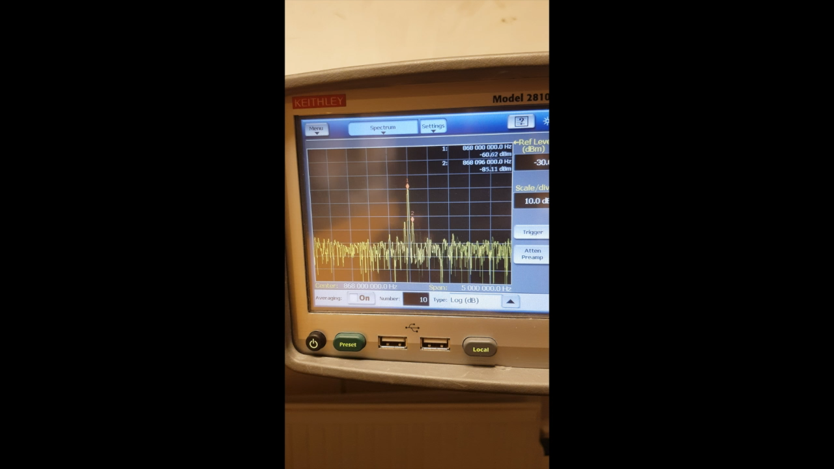
TunnelScatter with External Carrier Signal
Notes:
- Tunnel diode oscillator in presence of weak signal because of injection locking shows a significant gain.
- You can read more about injection locking in our paper. However, in a nutshell, it is a phenomenon where to oscillators synchronize to each other.
- We show this on spectrum in this experiment. In these plots the central signal is the carrier signal, while the remaining are backscattered and its harmonics.
- We first observe backscattered signal using conventional mechanism as employed in state-of-the-art backscatter systems. We see backscattered signal to be 20-30 dB lower in strength compared to ACS.
- Next, due to injection locking, we see with tunnelscatter mechanism the backscattered signal are almost of the same strength as weak carrier signal.
- This as we had seen earlier Allows us to achieve significant improvement in range with weak ACS

Slide 10
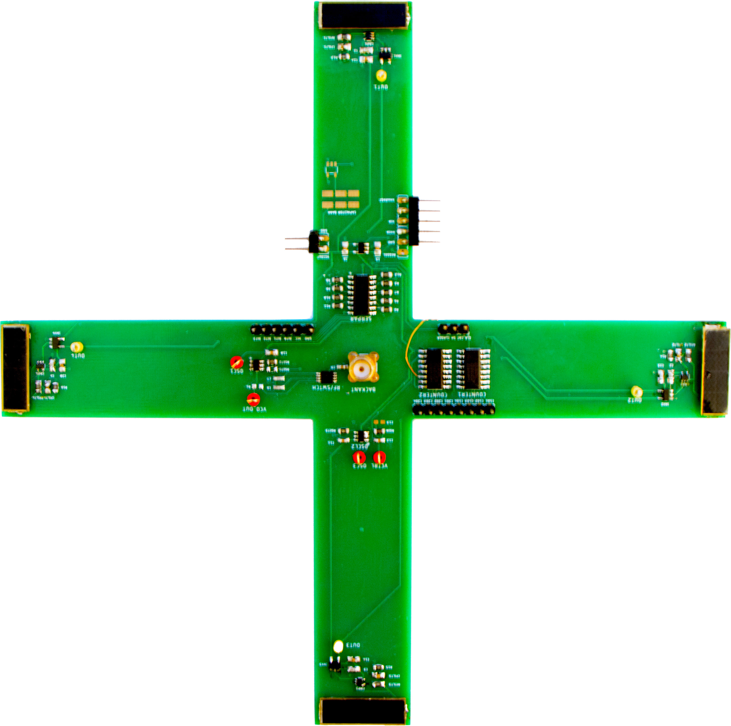
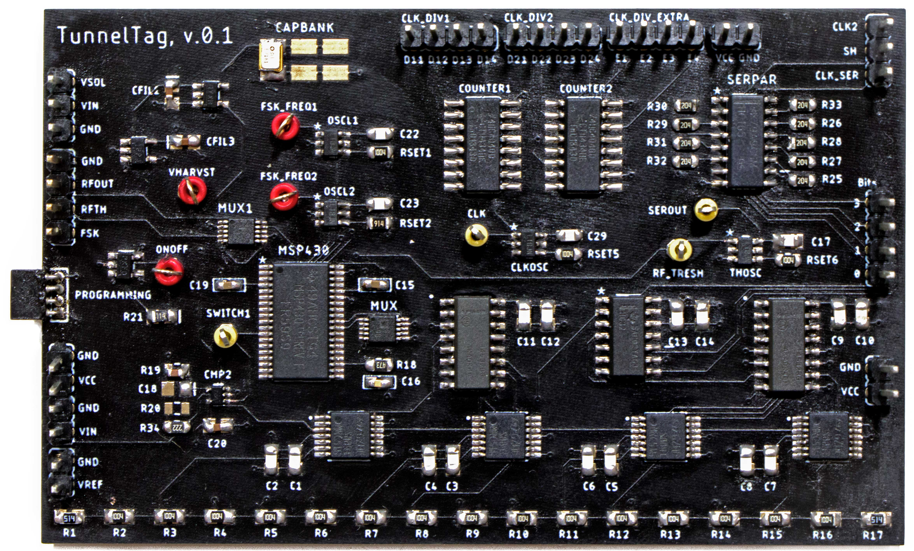
Conclusions
Operation under diverse external carrier strength
  Weak (Reflection Amplifier)
  Strong (Conventional Backscatter)
  Without (Oscillator)
Integrate tunnel diodes with long-range backscatter systems
Enables several application scenarios
  We prototype hand gesture sensing as concrete use case
Hand Gesture Sensing
Polymorphic Processing Pipeline
Notes:
We have presented TunnelScatter which enables operation in diverse conditions. We also support strong carrier signal with conventional mechanisms and you can read in our manuscript.
TunnelScatter is first system to integrate tunnel diode amplifier in long range backscatter systems.
Our manuscript also discusses many application scenarios that our system can enable. We prototype hand gesture sensing as one concrete use case. We show some of the hardware designed by Andreas, one of the coauthors, to enable these scenarios. You can read them in our draft.
With this I conclude my presentation, and will be happy to take any questions.

Slide 11
Q & A

Slide 12
Backup Slides

Slide 13
TunnelScatter with External Carrier Signal
Q: What happens to TunnelScatter in the presence of external carrier signal ?
Notes:
So while TO enables us to communicate even without requiring ACS, what happens when an ACS is already present ?
We observe that TDO demonstrates a phenomenon called injection locking
Injection locking is a phenomenon where two oscillators can synchronize to each other, and was first demonstrated in early 1600(s).
In our case, the TDO latches onto external ACS, and. Can modulate and transmit with a significant gain
As an example, in the figure on the slide, the bottom figure shows spectrum with free runnind TDO. The First figure shows spectrum with external signal latched onto TDO, which makes the backscattered signal extremely strong.
This enables us to achieve a significant gain while backscattering a weak ACS
(Signal strength injection )

Slide 14
Impact of ACS Strength
Reflection gain decreases with ACS strength (Impedance changes)
Higher ACS strength conventional mechanism outperforms
Solution: switchover mechanism controlled using envelope detector
Notes:
While TDO injection locks to a ACS, we encounter a challenge
We observe that the impedance of the TDO changes among other factors but also the strength of the incident RF signal
The reflection gain decreases as the ACS strength increase
Infact we observe that at higher ACS conditions, a conventional backscatter mechanism outperforms injection locked TDO
Hence to overcome this challenge we design a low power switchover mechanism to select between conventional RF switch and TDO
To detect the streg

